Slide 1
Blacktown Chinese Christian Church
Welcome to Our English Service 20.04.2025
English Service 9:45 – 11:00 am
Worship Songs: Passage: Speaker: Topic: Response Song: Announcements and Closing Prayer Benediction
Battle Belongs Because He Lives Nothing But The Blood Of Jesus 1 Corinthians 15:1-11 TBA TBA TBA

Slide 2
BCCC english service

Slide 3

Please keep all phones on silent

Slide 4
Battle Belongs
CCLI Licence No: 5485849

Slide 5
Verse 1
When all I see is the battle
You see my victory
When all I see is the mountain
You see a mountain moved

Slide 6
Verse 1
And as I walk through the shadow
Your love surrounds me
There's nothing to fear now
for I am safe with You

Slide 7
Chorus
So when I fight, I'll fight on my knees
With my hands lifted high
Oh God, the battle belongs to You

Slide 8
Chorus
And every fear I lay at Your feet
I'll sing through the night
Oh God, the battle belongs to You

Slide 9
Verse 2
And if You are for me, who can be against me?
For Jesus, there's nothing impossible for You
When all I see are the ashes, You see the beauty
When all I see is a cross, God, You see the empty tomb

Slide 10
Chorus
So when I fight, I'll fight on my knees
With my hands lifted high
Oh God, the battle belongs to You

Slide 11
Chorus
And every fear I lay at Your feet
I'll sing through the night
Oh God, the battle belongs to You

Slide 12
Bridge
Almighty fortress, You go before us
Nothing can stand against the power of our God
You shine in the shadow, You win every battle
Nothing can stand against the power of our God (x3)

Slide 13
Chorus
So when I fight, I'll fight on my knees
With my hands lifted high
Oh God, the battle belongs to You

Slide 14
Chorus
And every fear I lay at Your feet
I'll sing through the night
Oh God, the battle belongs to You

Slide 15
Tag
Oh God, the battle belongs to You

Slide 16
Because He Lives
CCLI Licence No: 5485849

Slide 17
Intro
Because He lives, I can face tomorrow
Because He lives, all fear is gone

Slide 18
Intro
Because I know He holds the future
And life is worth the living just because He lives

Slide 19
Verse 1
God sent His Son, they called Him Jesus
He came to love, heal and forgive
He lived and died to buy my pardon
An empty grave is there to prove my Savior lives

Slide 20
Chorus
Because Hе lives, I can face tomorrow
Becausе He lives, all fear is gone

Slide 21
Chorus
Because I know He holds the future
And life is worth the living just because He lives

Slide 22
Verse 2
And then one day, I'll cross that river
I'll fight life's final war with pain

Slide 23
Verse 2
And then as death gives way to victory
I'll see the lights of glory and I'll know He lives

Slide 24
Chorus
Because He lives, I can face tomorrow
Because He lives, all fear is gone

Slide 25
Chorus
Because I know He holds the future
And life is worth the living just because He lives

Slide 26
Bridge
Because He lives, I can face tomorrow
Because He lives, all fear is gone
Because I know He holds the future
And life is worth the living just because He lives

Slide 27
Chorus
Because He lives, I can face tomorrow
Because He lives, all fear is gone
Because I know He holds the future
And life is worth the living just because He lives

Slide 28
Chorus
Because He lives, I can face tomorrow
Because He lives, all fear is gone
Because I know He holds the future
And life is worth the living just because He lives

Slide 29
Outro
Because I know He holds the future
And life is worth the living just because He lives

Slide 30
Nothing But The Blood Of Jesus
Robert Lowry © Words: Public Domain Music: Public Domain CCLI Licence No. 5485849. CCLI Song number: 21332

Slide 31
Verse 1
What can wash away my sin?
Nothing but the blood of Jesus
What can make me whole again?
Nothing but the blood of Jesus

Slide 32
Verse 2
For my pardon this I see
Nothing but the blood of Jesus
For my cleansing this my plea
Nothing but the blood of Jesus

Slide 33
Chorus
Oh, precious is the flow
That makes me white as snow
No other fount I know
Nothing but the blood of Jesus

Slide 34
Verse 3
This is all my hope and peace
Nothing but the blood of Jesus
This is all my righteousness
Nothing but the blood of Jesus

Slide 35
Chorus
Oh, precious is the flow
That makes me white as snow
No other fount I know
Nothing but the blood of Jesus

Slide 36
Verse 4
Glory glory this I see
Nothing but the blood of Jesus
All my praise for this I bring
Nothing but the blood of Jesus

Slide 37
Chorus
Oh, precious is the flow
That makes me white as snow
No other fount I know
Nothing but the blood of Jesus (x2)

Slide 38

Bible reading

Slide 39
1 Corinthians 15:1-11 (NIV)
Now, brothers and sisters, I want to remind you of the gospel I preached to you, which you received and on which you have taken your stand. ² By this gospel you are saved, if you hold firmly to the word I preached to you. Otherwise, you have believed in vain.

Slide 40
1 Corinthians 15:1-11 (NIV)
³ For what I received I passed on to you as of first importance: that Christ died for our sins according to the Scriptures, ⁴ that he was buried, that he was raised on the third day according to the Scriptures,

Slide 41
1 Corinthians 15:1-11 (NIV)
⁵ and that he appeared to Cephas, and then to the Twelve. ⁶ After that, he appeared to more than five hundred of the brothers and sisters at the same time, most of whom are still living, though some have fallen asleep.

Slide 42
1 Corinthians 15:1-11 (NIV)
⁷ Then he appeared to James, then to all the apostles, ⁸ and last of all he appeared to me also, as to one abnormally born.

Slide 43
1 Corinthians 15:1-11 (NIV)
⁹ For I am the least of the apostles and do not even deserve to be called an apostle, because I persecuted the church of God. ¹⁰ But by the grace of God I am what I am, and his grace to me was not without effect. No, I worked harder than all of them—yet not I, but the grace of God that was with me.

Slide 44
1 Corinthians 15:1-11 (NIV)
¹¹ Whether, then, it is I or they, this is what we preach, and this is what you believed.

Slide 45
Scripture quotations taken from The Holy Bible, New International Version® NIV®
Copyright © 1973, 1978, 1984, 2011 by Biblica, Inc.
Used with permission. All rights reserved worldwide.

Slide 46
Announcements

Slide 47





Account name: Blacktown Chinese Christian Church
Account number: 4216 50263
Offering
BSB: 112 - 879
Please put in "offering" as the reference
The offering box is available at the back of the hall

Slide 48
Prayer points

Slide 49
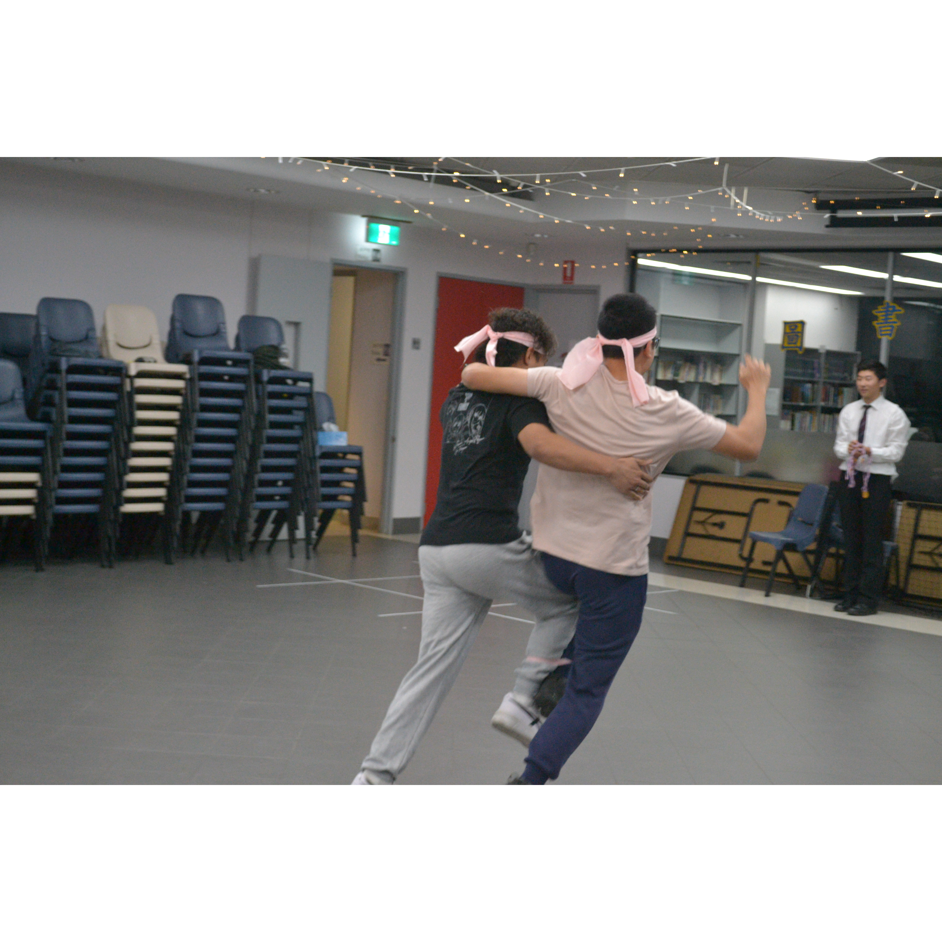
Mingle time!

